Slide 1
Serverless architecture
Notes:
Information in this document, including URL and other Internet Web site references, is subject to change without notice. Unless otherwise noted, the example companies, organizations, products, domain names, e-mail addresses, logos, people, places, and events depicted herein are fictitious, and no association with any real company, organization, product, domain name, e-mail address, logo, person, place or event is intended or should be inferred. Complying with all applicable copyright laws is the responsibility of the user. Without limiting the rights under copyright, no part of this document may be reproduced, stored in or introduced into a retrieval system, or transmitted in any form or by any means (electronic, mechanical, photocopying, recording, or otherwise), or for any purpose, without the express written permission of Microsoft Corporation.
Microsoft may have patents, patent applications, trademarks, copyrights, or other intellectual property rights covering subject matter in this document. Except as expressly provided in any written license agreement from Microsoft, the furnishing of this document does not give you any license to these patents, trademarks, copyrights, or other intellectual property.
The names of manufacturers, products, or URLs are provided for informational purposes only and Microsoft makes no representations and warranties, either expressed, implied, or statutory, regarding these manufacturers or the use of the products with any Microsoft technologies. The inclusion of a manufacturer or product does not imply endorsement of Microsoft of the manufacturer or product.
Links may be provided to third party sites. Such sites are not under the control of Microsoft and Microsoft is not responsible for the contents of any linked site or any link contained in a linked site, or any changes or updates to such sites. Microsoft is not responsible for webcasting or any other form of transmission received from any linked site. Microsoft is providing these links to you only as a convenience, and the inclusion of any link does not imply endorsement of Microsoft of the site or the products contained therein.
© 2021 Microsoft Corporation. All rights reserved.
Microsoft and the trademarks listed at https://www.microsoft.com/en-us/legal/intellectualproperty/Trademarks/Usage/General.aspx are trademarks of the Microsoft group of companies. All other trademarks are property of their respective owners.

Slide 2

Abstract and learning objectives
In this whiteboard design session, you work with a group to design a solution for processing vehicle photos in near real-time, as they are uploaded to a data lake, using serverless technologies on Azure. The license plate data must be extracted and stored in a highly available NoSQL data store for exporting. The data export process is orchestrated by a serverless Azure component that coordinates exporting new license plate data to file storage and sending notifications as needed. You will also configure a Continuous Deployment process to publish new changes to Function Apps automatically. Finally, the entire processing pipeline will need to be monitored, with particular attention paid to components scaling to meet processing demand.
At the end of this whiteboard design session, you will have greater insight into how best to take advantage of serverless architectures. You will understand better how to design highly scalable and cost-effective solutions that require very little code and virtually no infrastructure compared to traditional hosted web applications and services.
Notes:
Setup and configure a serverless architecture within Azure using a combination of Azure Functions, Logic Apps, Event Grid, Cosmos DB, and Azure Data Lake Storage Gen2. The focus is on removing server management from the equation, breaking down the solution into smaller components that are individually scalable, and allowing the customer to only pay for what they use.
Use a series of Azure Functions that independently scale and break down business logic into discrete components
Use computer vision algorithms within an Azure Function to accurately detect license plates in car images at scale
Provision and use Cosmos DB as a highly available NoSQL data store for processed data
Create a Logic App that contains a workflow to export processed license plates and conditionally send alerts based on successful or unsuccessful operation
Use App Insights to monitor the serverless topology, observing how well the solution scales when under load
Implement a Continuous Deployment DevOps process to automatically publish changes to Function Apps

Slide 3
Step 1: Review the customer case study
Outcome
Analyze your customer needs.
Timeframe
15 minutes

Slide 4
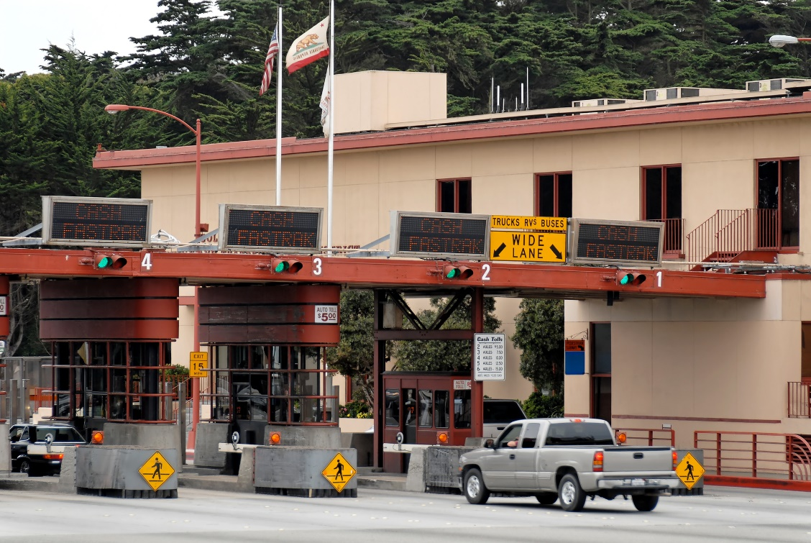
Customer situation
Contoso Ltd. manages a number of toll booths, taking photos of vehicles and billing the drivers.
License plate detection is currently a manual process.
They are trying to cope with being overloaded due to faster-than-expected growth.
Notes:
Contoso Ltd. added toll booth management as a one-off side project that works with their robust custom-built billing system. Their TollBooth software, which was meant to handle just a handful of local toll booths, had minimal development resources allocated to it. As such, Contoso has been using a manual process to identify license plates and send that data to their billing software. As a car passes through a toll booth, a medium resolution image is taken of the car to identify its license plate numbers/characters which will ultimately be used to look up and bill the customer. Currently, they periodically package and send those images to a 3rd party vendor, who manually identifies the license plate numbers and sends the list back to Contoso when they are done. At this point, Contoso collects batches of 1,000 transactions, saves the information to a CSV file hosted by an FTP server, where their downstream accounting system extracts the license plate information and bills the customer.
They have recently been awarded a very large contract to add an order of magnitude more toll booths they need to manage. Now they are trying to quickly cope with this new growth and automate the license plate detection process.

Slide 5

Customer situation - 2
Contoso is confident that their billing system can handle the load.
They are concerned about how rapidly they can automate the license plate processing while ensuring the new automated solution can scale to meet demand, especially during spikes in traffic.
Notes:
They are confident that their billing software can handle the load, as it has been the primary focus of development from the start, and has expanded into other markets, proving its ability to handle large-scale transactions and data processing. However, Contoso is concerned about how rapidly they can automate the license plate processing portion of their TollBooth infrastructure, while ensuring that the automated solution can scale to meet demand, particularly during unexpected spikes in traffic.

Slide 6

Customer situation - 3
Wants an automated workflow to export license plate data and send conditional alerts.
Would like to use machine learning service to perform license plate recognition task.
Needs to store images in cloud storage and data in database for export and manual verification.
Notes:
Since Contoso does not have any machine learning experts or data scientists on staff, they would like to know their options for using a ready-made machine learning service that can perform the license plate recognition task on the photos.
They need to store captured vehicle photos in cloud storage for retrieval via custom web and mobile applications. These photos will need to be accessible by the downstream billing service for inclusion on the customer bills. In addition, any photos containing license plates that could not be automatically detected, will need to be marked as such and accessed later on for manual validation. Similarly, as photos are successfully processed for license plate detection, the plate information needs to be saved to a database, along with the capture date/time and tollbooth Id. Contoso has a customer service department who can monitor the queue of photos marked for manual validation, and enter the license plates into a web-based form so they can be exported along with the automatically processed license plate data.
They want an automated workflow that runs on a regular interval to extract new license plate data since the last export and save it in a CSV file that gets ingested by the billing software. Customer service has requested that an alert email should be sent to a specific monitoring address if at any point the automated export does not complete due to no data. Given the export interval and the average number of vehicles that pass through the toll booths during any given hour, having no data to export would be the exception, not the rule.

Slide 7



Customer situation - 4
Our directors want to see where we can take the notion of a serverless architecture and see if there truly are long-term performance and cost benefits.
With the unexpected windfall of the toll booths contract, they want to make sure we have a tested strategy we can fall back on in the future...
Notes:
Contoso’s CIO, Abby Burris, believes that the dynamic scalability of serverless components, coupled with sub-second billing, would provide a cost-effective way to quickly build the automated solution using familiar development tools and programming languages to minimize developer training.
The important thing is being able to have a centralized monitoring dashboard they can use to watch the automated process execute in real time, and drill down into captured telemetry if needed.
Burris would like to know if it’s possible to locally develop the serverless components and automate the deployment process using continuous delivery DevOps practices like they can with their more traditional web applications.

Slide 8






Customer needs
Automate manual process using serverless.
Use ready-made machine learning service.
Manually enter license plate numbers for images that could not be processed.
Scalable solution that can handle unexpected demand.
Automated workflow that exports data.
Options to locally develop and automate deployment pipeline.
Centralized monitoring dashboard with real-time and historical viewing options.
Notes:
Replace manual process with a reliable, automated solution using serverless components
Take advantage of a machine learning service that would allow them to accurately detect license plate numbers without needing artificial intelligence expertise
Mechanism for manually entering license plate images that could not be processed
Have a solution that can scale to any number of cars that pass through all toll booths, handling unforeseen traffic conditions that cause unexpected spikes in processed images
Establish an automated workflow that periodically exports processed license plate data on a regular interval, and sends an alert email when no items are exported
Would like to locally develop the serverless components and establish an automated deployment pipeline from source control
Use a monitoring dashboard that can provide a real-time view of serverless components, historical telemetry data for deeper analysis, and supports custom alerts

Slide 9

Customer objections
How can the serverless components talk to each other?
Will the dynamic scalability of the serverless components end up costing us a lot of money?
How do we combat against erroneous image processing?
Notes:
We are concerned about how individual serverless components will be able to “talk” to each other and reliably pass messages through the pipeline
Will go to a serverless architecture that has the capacity to infinitely scale put us at risk for huge monthly bills?
How do we make sure that erroneous image processing does not make certain toll bills fall through the cracks or, even worse, send a bill to the wrong person?

Slide 10
Customer objections - 2
Can we add a secure, customer-facing API and how do we protect it from unauthorized access or an excessive number of requests?
What is our best option to protect application secrets?
Notes:
Is it possible to add a secure API that allows our customers to retrieve information about their vehicles plus captured photos? How do we protect our system from unauthorized access or an excessive number of requests?
What is our best option to protect application secrets, such as connection strings, from being viewed by unauthorized users in the portal?

Slide 11
Customer objections - 3
Help us understand when to use Azure Functions versus Logics Apps.
Are “cold starts” going to be an issue if we use serverless technologies in Azure?
Notes:
There appears to be some functional overlap between Azure Functions and Logic Apps. Can you help us to understand better when to use each and for what?
During our research on serverless architectures, we have read about the possibility of increased latency due to cold starts. Will this be an issue with Azure Functions?

Slide 12
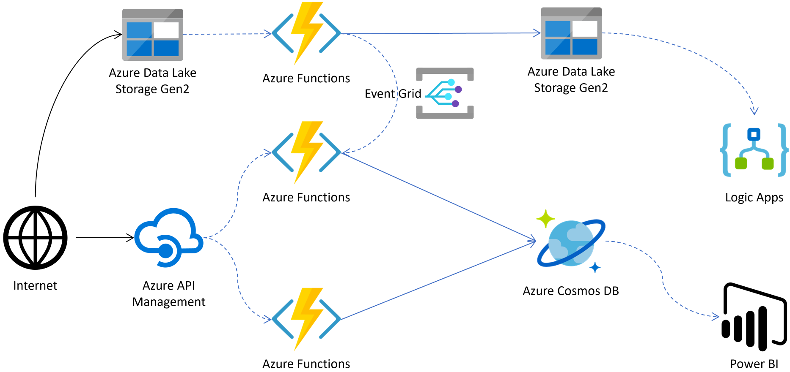
Common scenarios
Notes:
This is a diagram of a common architecture for this type of scenario from which you can draw inspiration. You will find this diagram within the student guide.

Slide 13
Step 2: Design the solution
Outcome
Design a solution and prepare to present the solution to the target customer audience in a 15-minute chalk-talk format.
Timeframe
60 minutes
Business needs (10 minutes) | Respond to questions outlined in your guide and be prepared to present your solutions to others.
Design (35 minutes) | Design a solution for as many of the stated requirements as time allows.
Prepare (15 minutes) | Identify any customer needs that are not addressed with the proposed solution. Identify the benefits of your solution. Determine how you will respond to the customer’s objections. Prepare for a 15-minute presentation to the customer.

Slide 14
Step 3: Present the solution
Outcome
Present a solution to the target customer in a 15-minute chalk-talk format.
Timeframe
30 minutes (15 minutes for each team to present and receive feedback)
Directions
Pair with another team.
One group is the Microsoft team and the other is the customer.
The Microsoft team presents their proposed solution to the customer.
The customer asks one of the objections from the list of objections in the case study.
The Microsoft team responds to the objection.
The customer team gives feedback to the Microsoft team.
Switch roles and repeat Steps 2-6.

Slide 15
Wrap-up
Outcome
Identify the preferred solution for the case study.
Identify solutions designed by other teams.
Timeframe
15 minutes

Slide 16

Preferred target audience
Abby Burris, Chief Information Officer, Contoso, ltd.
The primary audience is business decision makers and technology decision makers.
Usually, we talk to the Infrastructure Managers who report into the CIOs, or to application sponsors (like a VP LOB, CMO) or to those that represent the Business Unit IT or developers that report into application sponsors.

Slide 17
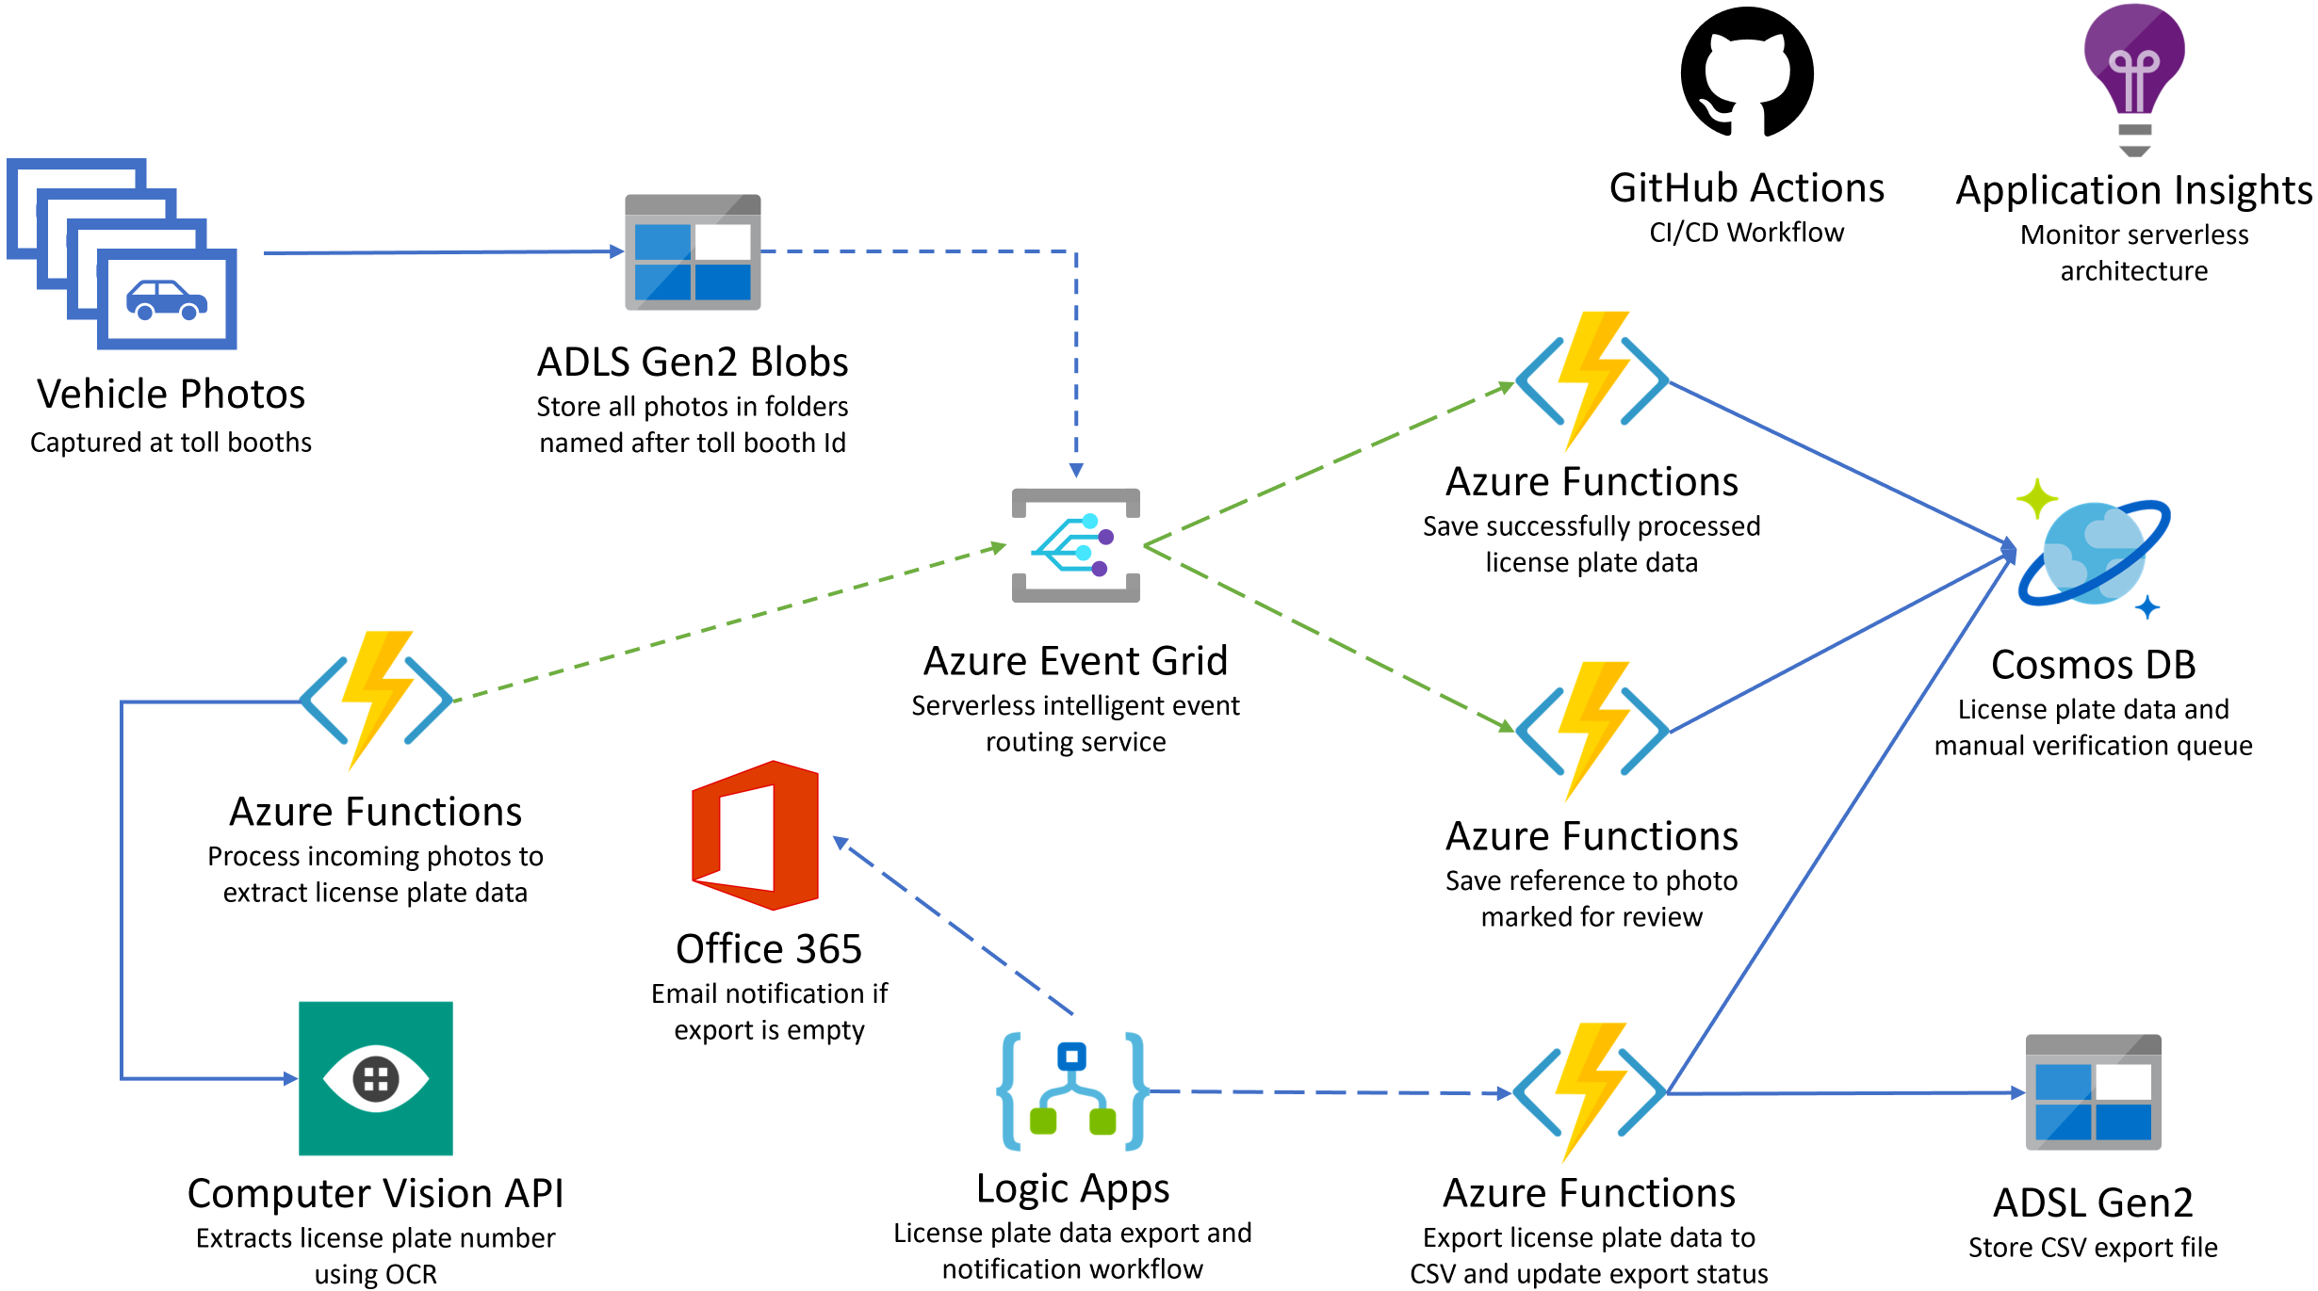
Preferred solution - overall
Notes:
The solution begins with vehicle photos being uploaded to an Azure Data Lake Storage (ADLS) Gen2 container as they are captured. Each image is stored in a subfolder named after the photo booth's Id so the Id can be added to the processed license plate data in the database. An Event Grid subscription is created against the data lake storage blob created event, calling the photo processing Azure Function endpoint (on the side of the diagram), which in turn sends the photo to the Cognitive Services Computer Vision API OCR service to extract the license plate data. If processing succeeds and the license plate number is returned, the function submits a new Event Grid event, along with the data, to an Event Grid topic with an event type called "savePlateData." However, if the processing was unsuccessful, the function submits an Event Grid event to the topic with an event type called "queuePlateForManualCheckup." Two separate functions are configured to trigger when new events are added to the Event Grid topic. Each function filters on a specific event type, saving the relevant data to the appropriate Cosmos DB collection for the outcome, using the Cosmos DB output binding. A Logic App that runs on an hourly interval executes an Azure Function via its HTTP trigger, responsible for obtaining new license plate data from Cosmos DB and exporting it to a new CSV file saved to the data lake. If no new license plate records are found to export, the Logic App sends an email notification to the Customer Service department via their Office 365 subscription. Application Insights is used to monitor all Azure Functions in real-time as data is being processed through the serverless architecture. This real-time monitoring allows Contoso to observe dynamic scaling first-hand and configure alerts when certain events take place. GitHub Actions is used to manage the DevOps processes and the CI/CD workflow. Azure Key Vault is used to securely store secrets, such as connection strings and access keys. Key Vault is accessed by the Function Apps through an access policy within Key Vault, assigned to each Function App's system-assigned managed identity.

Slide 18
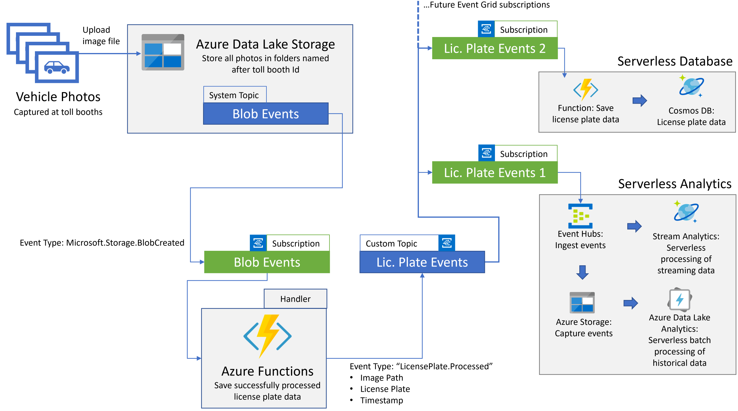

Preferred solution – serverless analytics
Notes:
As the following diagram illustrates, Contoso could design their solution to be extensible using an Event Grid Custom Topic. Whenever the license plate image is successfully processed, the Azure Function that saves the license plate data to Cosmos DB could instead be extended to enqueue an event into a Custom Topic. The enqueued custom topic would have an event type of "LicensePlate.Processed," a data payload of the image path (in ADLS), the extracted license plate text, and the image's timestamp was captured. Other Event Grid subscriptions could later be created against this topic, listening for the aforementioned event types.
With the aforementioned custom topic in place, you could achieve both near-real-time and batch analytics are possible by configuring a new subscription that uses an Event Hubs instance as the handler.
You would configure Event Hubs Capture to write the ingested messages periodically (defined in terms of the volume of messages in MB or the length of a sliding window) to Azure Storage. From ADLS Gen2, you could use Azure Data Lake Analytics to batch process the data, join it with other lookup data or perform other transformations. Azure Data Lake Analytics allocates resources to your jobs automatically and is completely serverless.
Similarly, from the same Event Hubs instance, you could connect Azure Stream Analytics to apply standing SQL queries to analyze the time-series data (such as by computing aggregates over windows of time) in near-real-time and output the result to several Azure services like SQL Database or Power BI.

Slide 19




Preferred solution
License plate processing serverless components
Orchestrate event-driven activities with Event Grid.
Use Azure Functions for serverless compute with the consumption plan.
Research and test downstream services to see if they can handle high demand – implement rate-limiting and resiliency strategy as needed.
Use Cosmos DB to store license plate data.
Notes:
Which Azure messaging service would you recommend using to orchestrate event-driven activities between the serverless components?
- Event Grid for reliable event-driven, reactive programming.
What Azure service would you suggest Contoso use to execute custom business logic code when an event is triggered?
- Azure Functions, a serverless compute service that enables you to run your custom business logic code on demand without the need to provision or manage infrastructure, dynamically scales to meet demand, and enables you to pay only for the compute resources used.
Which pricing tier for the service would you recommend that would automatically scale to handle demand while charging only for work that was performed?
- An Azure Functions Consumption plan. In this scenario, none of the functions are particularly long-running, and the Consumption plan meets the requirement that charges are only incurred when work is performed.
How do you ensure that downstream components, such as machine learning APIs, databases, and file stores, are not overloaded by the potential high load created when your serverless components dynamically scale?
- During the design and testing phases of the application development, it is crucial to verify that downstream components can handle the potential high load created by the dynamic scaling of the serverless computing tier. Review external services for rate limits, perform load testing, then configure concurrency settings on the triggers to limit how many HTTP functions can be executed in parallel. Another option is to implement a resiliency strategy in code, such as a retry pattern and/or a circuit breaker pattern, giving the downstream service time to recover.
What Azure service would you recommend for storing the license plate data? Consider options that automatically scale to meet demand, and offer bindings to other serverless components that simplify connecting to and storing data within the data store.
- Use Azure Cosmos DB, which is a globally distributed, massively scalable, multi-model database service that includes native integration with Azure Functions. You can use output bindings directly to Cosmos DB from your functions, simplifying the steps needed to persist your incoming license plate processing data.

Slide 20

Preferred solution - 2
License plate OCR
Use the Cognitive Services Computer Vision API and its built-in OCR capabilities.
The image processing function can make a REST call to send the photo and read the JSON data in return.
Notes:
What service would you recommend Contoso use to conduct license plate object character recognition (OCR) processing to extract the license plate number from each photo as it enters the system?
- Since Contoso has stated that they have no in-house expertise in machine learning or data science, the simplest approach would be to use the Cognitive Services Computer Vision API and its built-in OCR capabilities.
How would you integrate the OCR service to your license plate processing flow?
- The Computer Vision API can be integrated by having the image processing function make a REST request containing the photo to the registered service endpoint. It is highly recommended that a resiliency strategy is implemented for the call, in case the service is imposing rate limits on your requests during high traffic periods. The return data is in JSON format, containing the discovered text and bounding boxes indicating their position within the photo.

Slide 21
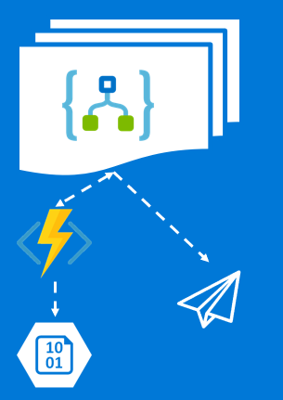
Preferred solution - 3
Data export workflow
Create a Logic App with the following:
Recurrence trigger that executes every hour then
Executes Azure function that exports CSV to storage then
Uses conditional logic to evaluate response code from the function and send email using Office 365 Outlook connector
Notes:
What Azure service would you recommend Contoso use to create an automated workflow that runs on a regular interval to export processed license plate data and send alerts as needed? - Logic Apps would help integrate an automated workflow without worrying about building hosting, scalability, availability, and management. You would add a recurrence trigger to the logic app that fires on a defined schedule. The logic app would execute the Azure function that collects new processed license plate data and exports it to a CSV file in Azure Data Lake Storage Gen2.
Which other services would you integrate into your workflow?
- Contoso has stated that they use Office 365 services for their email. Logic Apps can use the Office 365 Outlook connector to send emails to any number of recipients. Start by adding a condition after the call to the Azure function. This condition needs to evaluate the response code sent by the function to determine whether the email step is fired. If the code is not equal to 200 (OK status), then the email should be sent with information in the body crafted based on the response code. For instance, the function should return a 204 (NoContent) status code if no license plate data was found that needs to be exported. This would indicate that no photos were processed in the period since the previous trigger interval, possibly indicating a situation out of the norm that should be investigated more closely.

Slide 22

Preferred solution - 4
Monitoring and DevOps
Develop & debug Function Apps locally with Azure Functions Core Tools.
Automate function deployments through App Service continuous integration – use integrated source repo like GitHub, DropBox or Azure DevOps.
Monitor all executing serverless components with App Insights, in real-time, and use it to configure alerts and view historical telemetry.
Notes:
What tools and services would you recommend Contoso use to develop the serverless components locally, synchronize with a source code repository, and implement continuous deployment? The Azure Functions Core Tools is a local version of the Azure Functions runtime that can run on your local computer for debugging during your development process or run in a local, isolated environment. The core tools use the same runtime that powers Functions in Azure, and it can be installed using the NodeJS package manager (npm). Though the core tools can be used from the command line or with several code editors, the best integration is with Visual Studio.
You can facilitate automated deployments of your function app through App Service continuous integration. Use one of the integrated services for your source code repository, such as BitBucket, Dropbox, GitHub, and Azure DevOps, enabling a workflow whereby a deployment to Azure is triggered when your function code is pushed to your repository. This continuous delivery setup deploys the entire Function App, not a single function. If a function needs to change independently, it is best to deploy it as a separate Function App.
GitHub Actions provide a way to automate, customize, and execute your software development workflows right in your repository. You can discover, create, and share actions to perform any job you'd like, including CI/CD, and combine activities in a completely customized workflow.
How would you monitor all the executing serverless components in real time from a single dashboard? - Use Azure Application Insights with built-in integration with Azure Functions. Use the Live Metrics Stream feature to view the incoming requests, outgoing requests, overall health, allocated server information, and sample telemetry in near-real time. This will help you observe how your functions scale under load and allows you to spot any potential bottlenecks or problematic components, through a single interactive interface.
Does your monitoring solution support exploring historical telemetry and configuring alerts? - Yes, Application Insights makes it easy to configure alerts and explore current and historical telemetry and log data.

Slide 23
Preferred objections handling
How can the serverless components talk to each other?
Will the dynamic scalability of the serverless components end up costing us a lot of money?
How do we combat against erroneous image processing?
Notes:
We are concerned about how individual serverless components will be able to "talk" to each other and reliably pass messages through the pipeline.
Azure Functions support multiple triggers, including several Azure services and basic yet flexible trigger types such as HTTP and webhook triggers. In our proposed solution, we use Event Grid bindings that allow events to trigger certain functions. These bindings enable other functions to send data to the reliable queue through an Event Grid topic and designate a specific event type. Hence, functions that need to react to particular events only respond to the filtered events they care about.
Will a serverless architecture that can infinitely scale put us at risk for substantial monthly bills?
Azure Functions comes in three primary offerings, consumption, dedicated, and premium. Understanding the differences between them is essential, as choosing one over the other dictates your application's behavior and how you're billed.
The consumption plan is Microsoft's "serverless" model. In this model, your code reacts to events, effectively scales out to meet load, scales down when code isn't running, and you're billed only for what you use. One of the primary benefits of using serverless components in a consumption plan is that billing is based on resources consumed or the actual time your code is running. For many event-driven workflows, sub-second billing will save more money in the long run compared to paying for constantly running resources, whether they are used or not. When using Azure Functions, short-lived and sporadic use will benefit most from the consumption plan. Most serverless components also provide options to specify upper limits on things like concurrent executions and other rate-limiting options.
However, if you are consistently getting a lot of traffic or have many long-running operations, the dedicated or premium tiers might be more cost-effective. The dedicated plan involves renting control of a virtual machine and a dedicated Azure App Service plan. This control means you can do whatever you like on that machine. It's always available and might make more sense financially if you have functions that need to run 24/7.
When you use the premium plan, instances of the Azure Functions host are added and removed based on the number of incoming events, just like with the Consumption plan. You can also deploy multiple function apps to the same Premium plan, and it allows you to configure the size characteristics of your compute instance.
How do we make sure that erroneous image processing does not make specific toll bills fall through the cracks or, even worse, send an invoice to the wrong person?
Erroneous image processing is handled in our solution by creating a manual verification queue when the OCR process fails or the result's confidence level is low. For example, we can filter out invalid characters and use an empty result to indicate low confidence in the predicted license plate text. More advanced machine learning models may be employed with algorithms specifically tuned to license plate recognition (LPR). Part of the result would include a confidence level, which the system could use to decide whether the photo needs manual verification.

Slide 24
Preferred objections handling - 3
Can we add a secure, customer-facing API and how do we protect it from unauthorized access or an excessive number of requests?
What is our best option to protect application secrets?
Notes:
We are considering creating an API to allow our customers to retrieve information about their bills and photos that captured their vehicle but are concerned about unauthorized access and the possibility of a denial of service attack due to an excessive number of requests. Is there an Azure service that would enable us to implement a secure API that we can also monitor and manage, protecting our APIs from unauthorized access and excessive requests?
Given the nature of Contoso's serverless architecture, they can quickly expand functionality by adding more Azure functions. For instance, they can add a new function with an HTTP trigger that runs when a client hits the endpoint. This function can process GET requests with a customer Id or custom identifier, which will return information for that customer's vehicles and any captured photos.
If Contoso would like to add a layer of protection, they should consider using Azure API Management (APIM). This service provides a consistent surface area for API endpoints you wish to expose to the public, including the new Azure function that will serve customers' information.
What is our best option to protect application secrets, such as connection strings, from being viewed by unauthorized users in the portal?
Azure Key Vault can be used to securely store and tightly control access to tokens, passwords, certificates, API keys, and other secrets. Also, secrets stored in Azure Key Vault are centralized, giving the added benefits of only needing to update secrets in one place, such as an application key value after recycling the key for security purposes. Contoso can store their secrets in Azure Key Vault, then configure their Function Apps to securely connect to Azure Key Vault.

Slide 25
Preferred objections handling - 4
Help us understand when to use Azure Functions versus Logics Apps.
Are “cold starts” going to be an issue if we use serverless technologies in Azure?
Notes:
There appears to be some functional overlap between Azure Functions and Logic Apps. Can you help us to understand better when to use each and for what?
Both Functions and Logic Apps are Azure services that enable serverless workloads capable of using complex orchestration steps to accomplish tasks. The primary differentiator between them is that Azure Functions is a serverless compute service, whereas Azure Logic Apps provides serverless workflows. You can mix and match services when you build an orchestration, calling functions from logic apps and calling logic apps from functions.
Functions emphasize code-first versus the design-first approach offered by logic apps. For Azure Functions, you write code in various languages, like C#, Node.js, Python, Java, and PowerShell, and you can add orchestration using the [Durable Functions](https://docs.microsoft.com/azure/azure-functions/durable/durable-functions-overview?tabs=csharp) extension to create stateful workflows. You can secure Azure Functions using Authorization keys that are automatically generated and implement additional security measures using the dedicated and premium tiers. For Logic Apps, you create orchestrations using a graphical user interface (GUI) or editing configuration files. Logic Apps makes implementing security very simple. Every connector includes the authentication components needed to connect to the target service, such as the Office 365 Outlook connector requires an Office 365 account.
During our research on serverless architectures, we have read about the possibility of increased latency due to cold starts. Will this be an issue with Azure Functions?
Cold start is a significant discussion point for serverless architectures and is a point of ambiguity for many users of Azure Functions. Concerning Azure Functions, a cold start is only a concern when your Functions use the serverless consumption model. When using Azure Functions in the dedicated or premium plans, the Functions host is always running, which means that cold start is not an issue.
By cold start, we are broadly describing the phenomenon that applications that have not been used take longer to start up. In the context of Azure Functions, latency is the total time a user must wait for their function to execute. This time runs from when an event happens to trigger a function until it completes responding to the event. More precisely, a cold start is an increase in latency for Functions that haven’t been called recently.
Cold start happens due to the serverless nature of the Azure Functions consumption plan. When you execute function code, the following steps must occur to run your code:
- Azure must allocate your application to a server with capacity.
- The Functions runtime must then start up on that server.
- Your code then needs to execute.
To make this experience better for users, instead of starting from scratch every time, Microsoft has implemented a way to keep a pool of servers warm and draw workers from that pool. This pool means that idle workers preconfigured with the Functions runtime are up and running and available at any point in time. These “pre-warmed sites” provide a measurable improvement on cold start times.
Other suggestions to improve this are to use only generally available (GA) languages when writing your function code and focus on writing efficient, lightweight code with minimal dependencies. When you deploy your code, your dependencies are added as files to your application. All code needed by your app eventually gets loaded into memory, which takes longer with a larger application. So, if you have many dependencies, you may experience a longer cold start due to increased time for I/O operations from Azure Files and the increased time needed to load the app into memory.
If cold start times are still an issue, consider using Azure Functions in the dedicated or premium plans, as a cold start is not an issue.

Slide 26
Customer quote
"Thanks to Azure's serverless components, and the ease in which we can use them, we have been able to rapidly build a cost-effective and robust solution to replace our manual license plate recognition process. The first-class monitoring tools we can use with our new architecture have helped us confidently move forward and competently meet the high demands of our expanding customer base.“
Abby Burris, CIO, Contoso, ltd.

